Slide 1

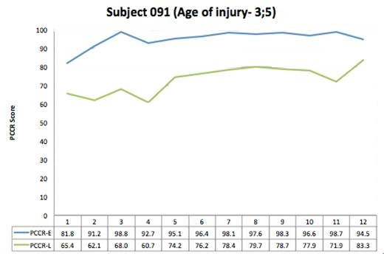
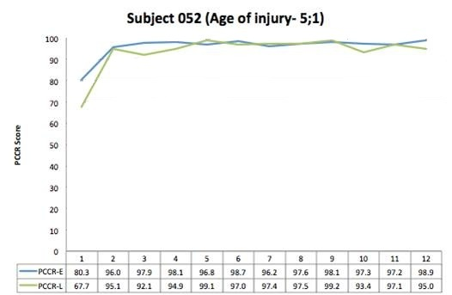
How does age at injury affect recovery of early and late consonants in pediatric TBI?
Justin Lo and Chris Dollaghan
The University of Texas at Dallas, Callier Center for Communication Disorders
Callier Center
for Communication Disorders
PURPOSE
DESCRIPTIVE RESULTS
ANALYSIS
For cases of severe pediatric traumatic brain injury (TBI), age at injury is positively correlated with speech outcome after 12 months as measured by Percentage of Consonants Correct.^{[1]}
Specifically, children injured earlier in process of acquiring speech (< 60 mos) sustained more deficits than those injured later, when speech skills are largely consolidated.^{[1]}
The 24 English consonants can be sorted into three classes according to approximate ages of acquisition: Early-8 (/m, b, j, n, w, d, p, h/), Middle-8 (/t, ŋ, k, g, f, v, tʃ, dʒ/), Late-8 (/ʃ, θ, s, z, ð, l, r, ʒ/). ^{[2]} Early-8 and some Middle-8 consonants are normally mastered by ages 3 to 4, whereas most Late-8 consonants may be mastered as late as ages 6 to 7. ^{[2,3]}
The purpose of this study was to compare recovery of Early-8 and Late-8 consonants in children injured before and after 60 mos of age.
At the final session, PCCR-E scores for the groups were comparable, but the younger group had a lower mean PCCR-L (Table 1)
Table 2 shows the number of children in each group with divergent and convergent patterns at final session
Younger group had significantly more divergent outcomes than older group (OR=17.5, 95% CI=1.6, 191.9, z=2.34 p=0.019)
.
Table 1. Mean PCCR-E and PCCR-L at final sample by group
Age at injury (yrs) PCCR-E PCCR-L
3;0 – 5;0 (n = 11) 96.7 81.2
5;1 – 7;1 (n = 11) 98.2 92.7
Table 2. Convergent and divergent patterns at final sample by group
Age at injury (yrs) Divergent Convergent
3;0 – 5;0 7 4
5;1 – 7;1 1 10
Two patterns were identified at the final session
    Divergent – PCCR-L lags PCCR-E by > 10% (Figure 1)
    Convergent – PCCR-L and PCCR-E converge (Figure 2)
DISCUSSION
Figure 1
Children injured at younger ages (3;0-5;0 yrs) were more likely than children injured later (5;1-7;1 yrs) to show a lag between Late-8 and Early-8 consonant accuracy
Results are consistent with hypothesis that TBI during consolidation of a skill (e.g., Late-8 consonants for the younger group) is more disruptive than TBI occurring after a skill has been consolidated (e.g., Late-8 consonants for older group)
More research is needed concerning the potential value of considering age of injury in relation to different consonant classes for assessing outcomes and providing treatment
METHOD
Two groups defined by age at injury:
  Younger (36-60 mos or 3;0-5;0 yrs at injury), N = 11
  Older (61-85 mos or 5;1-7;1 yrs at injury), N = 11
All children with complete speech data sets from a larger study of severe pediatric TBI were included ^{[1]}
Monolingual English-speaking families; no diagnosed language or neurodevelopmental deficits
Recovery curves from 12 monthly speech samples beginning when the child produced 10 words were plotted for Percentage of Early-8 Consonants Correct Revised (PCCR-E) and Percentage of Late-8 Consonants Correct Revised (PCCR-L)
PCCR metrics score omitted and substituted (but not distorted) consonants as errors
Figure 2
REFERENCES AND ACKNOWLEDGEMENTS
[1]Campbell TF, Dollaghan C, Janoksy J, Rusiewicz HL, Small SL, Dick F, Vick J, & Adelson PD (2013). Consonant Accuracy After Severe Pediatric Brain Injury: A Prospective Cohort Study. JSLHR, 56, 1023-1034.
[2]Shriberg, LD (1993). Four New Speech and Prosody-Voice Measures for Genetics Research and Other Studies in Developmental Phonological Disorders. Journal of Speech and Hearing Research, 36, 105-140.
[3]Austin D & Shriberg LD (1997). Lifespan Reference Data for Ten Measures of Articulation Competence Using the Speech Disorders Classification System (SDCS). Phonology Project Technical Report 3, Waisman Center. University of Wisconsin-Madison, 1-20.
The archival data set used in this presentation was originally supported NIH and GCRC grants to Thomas F. Campbell, who generously provided access and assistance for these analyses. We thank the original study’s participants, co-investigators, and research assistants, and we also thank Lawrence Shriberg and the staff of the Phonology Project at the University of Wisconsin-Madison for assistance with the original speech analyses.

